Slide 1


BRAND IDENTITY DESIGN
BRANDCRAFTERS
A Design Company
Prepared by
DHANUSH M
DWIJESH SREERAM S

Slide 2
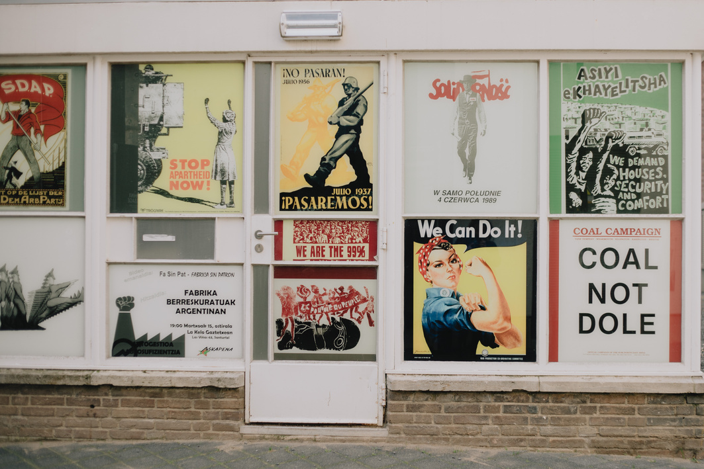
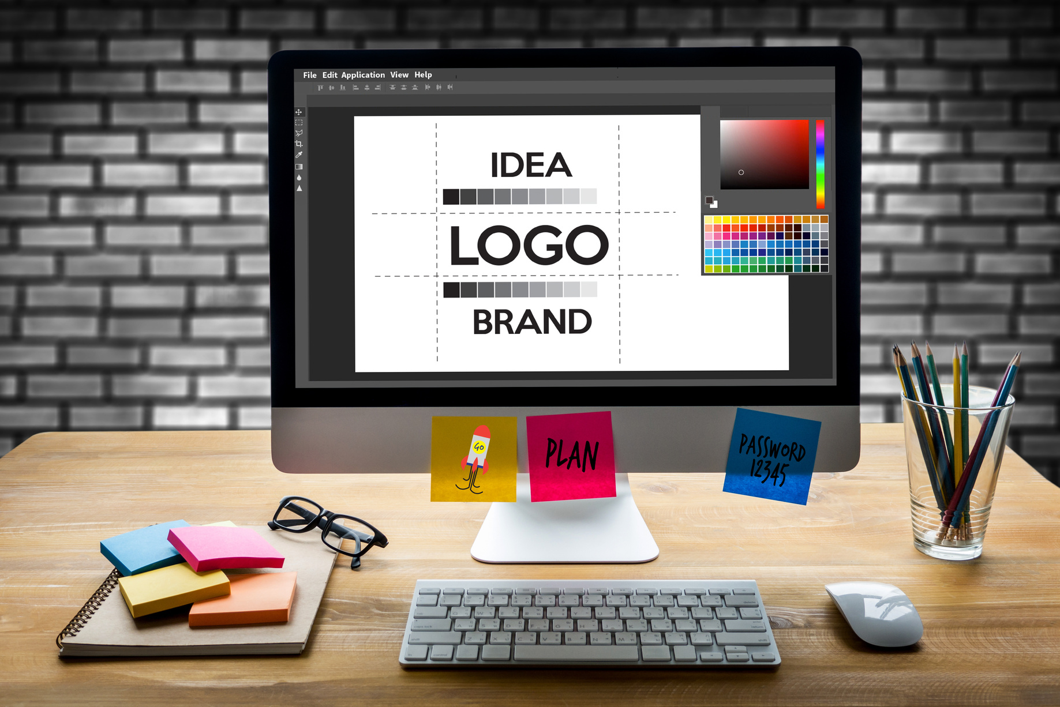

INTRODUCTION
Today, the effective design is crucial for establishing brand identity and connection with our customers . Our company recognises the importance of creating strong and visual engaging material that communicates our values, vision and offerings. This project is focus on creating the key design elements including logos, calendars and posters which will enhance our brand identity. By designing these materials , we aim to build a strong visual presence to our customers and set us apart in the market.

Slide 3



ABSTRACTY
In our project, we intend to do product design like logo design, posters, Products with our brand identity, banners for our Company . The logo design process will give more memorization and relevance to our company's value. The calendar design provides both utility and a consistent brand experience throughout the year. The poster design will show our campaign product, event, impactful communication through creative visuals. overall it will create a brand identity to our Company.

Slide 4
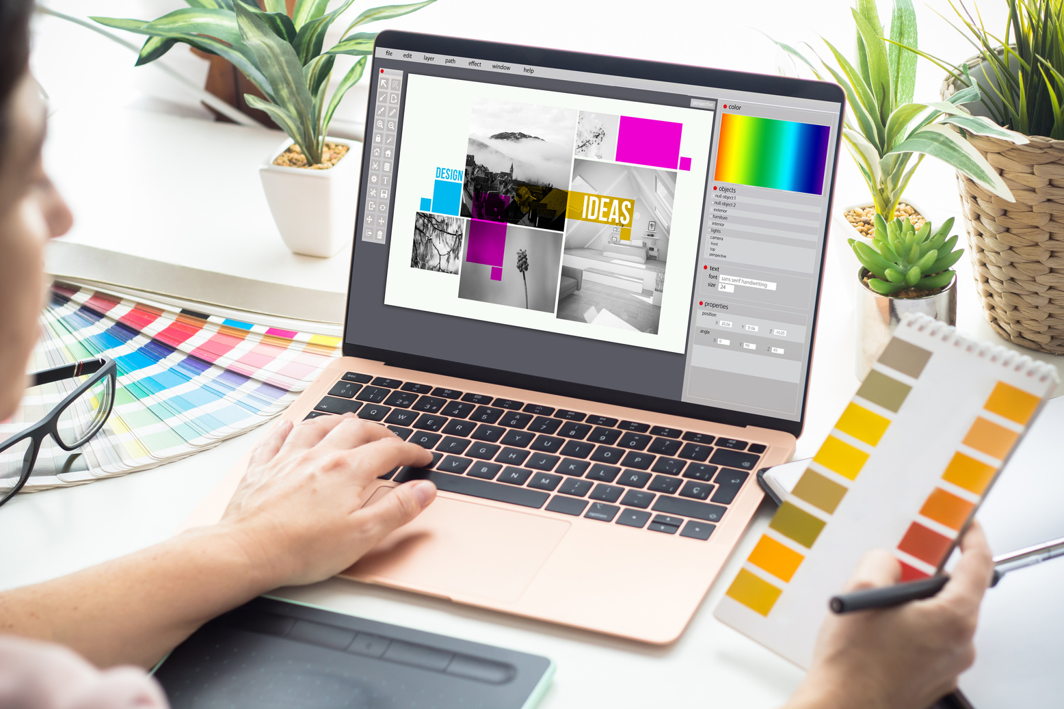

OBJECTIVE
To create visually cohesive designs that effectively communicate the company's identity, values, and offerings. The designs aim to engage the target audience, enhance brand recognition, and promote the company's services or products. By combining creativity with functionality, the logos, calendars, and posters will serve as powerful tools for marketing, customer engagement, and reinforcing the company’s presence in its industry.

Slide 5


LITERATURE SURVEY
Co-Optex
Pothys
Arvind
FONT
Times New Roman
Georgia and Brush Script
Roboto and Helvetica
Red, gold, and green
Gold, deep red, and maroon
Shades of Blue and white
COLOR
By Reviewing and taking surveys from other Industry designs, they will design logos and promoting their products for branding. But our product design that shows industry’s not only a promoting a brand and also shows a vision and mission of our industry. So, this will promote our products to the Audience easily.

Slide 6


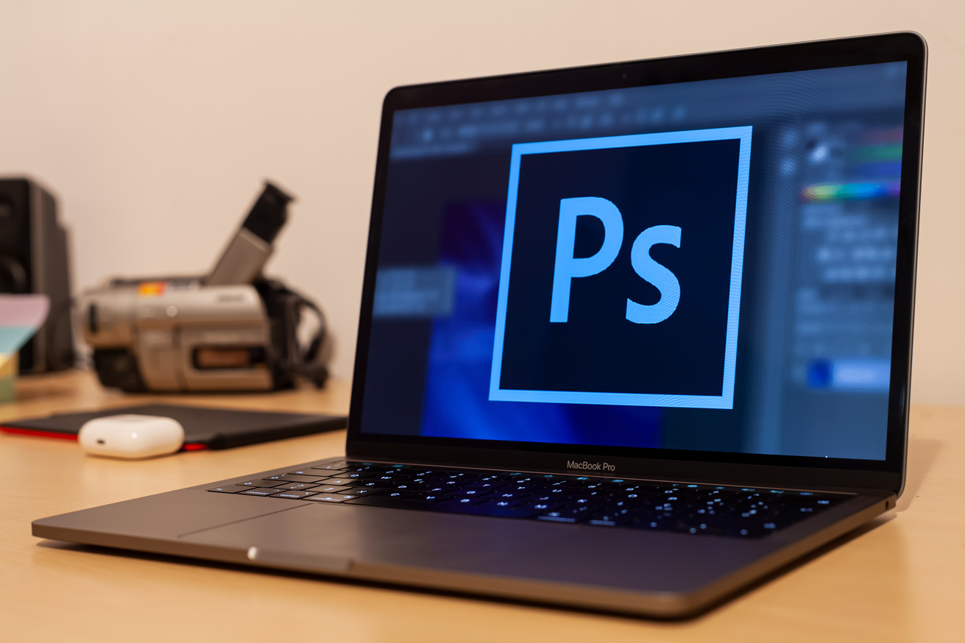
PROPOSED METHODOLOGY
In our project ,we use simple geometric shapes and we develop that can adapt to different themes, it also have unique typeface for your brand that resonates with its identity.
In calendar, we design with Feature different themes each month, such as sustainability, culture, innovation, or your company milestones.
The posters that are created for company events with striking visuals and cohesive branding and with the help of abstract designs that subtly integrate your company logo or core elements of your brand

Slide 7

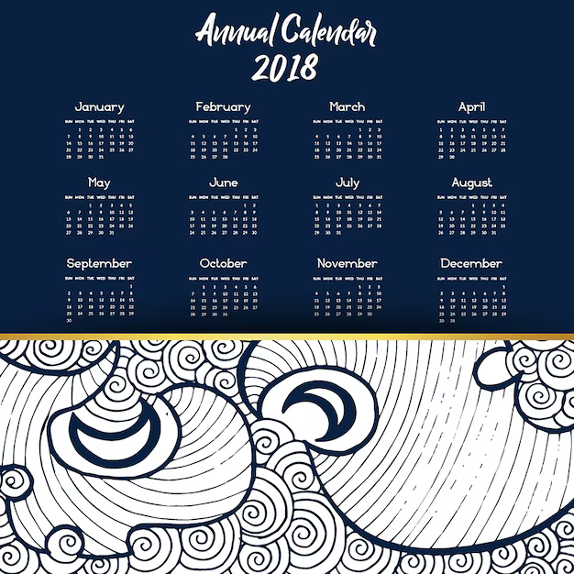


EXPECTED OUTPUT
LOGO DESIGN
CALENDER DESIGN
POSTER DESIGN
IDENTITY CARDS, PRODUCT DESIGNS, this are our overall project.

Slide 8






POSTER
INSTITUTION LOGO
An Education Institution Graphic Design Project

Slide 9
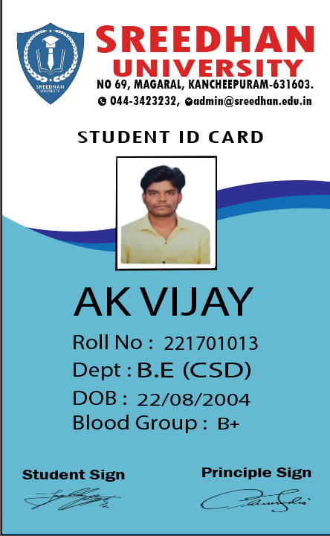
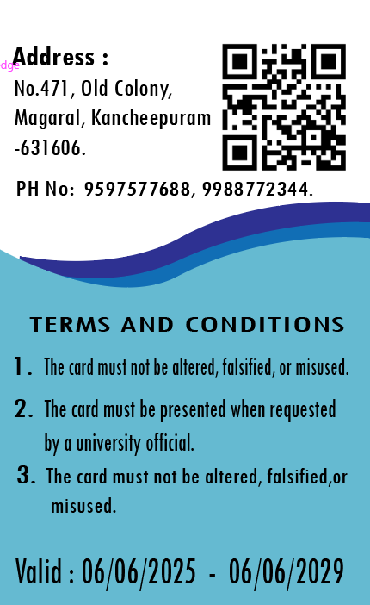
STUDENT ID CARD DESIGN
An Education Institution Graphic Design Project

Slide 10
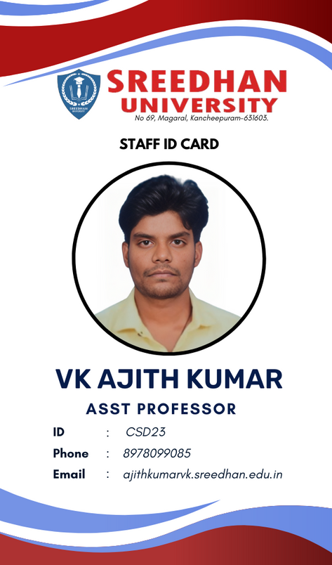
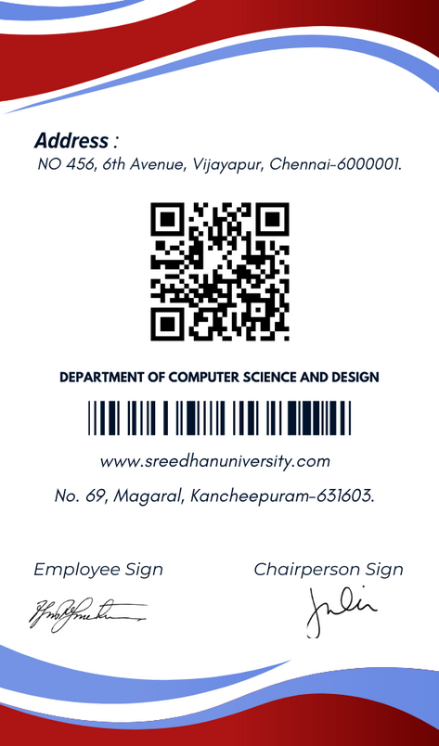
STAFF ID CARD DESIGN
An Education Institution Graphic Design Project

Slide 11
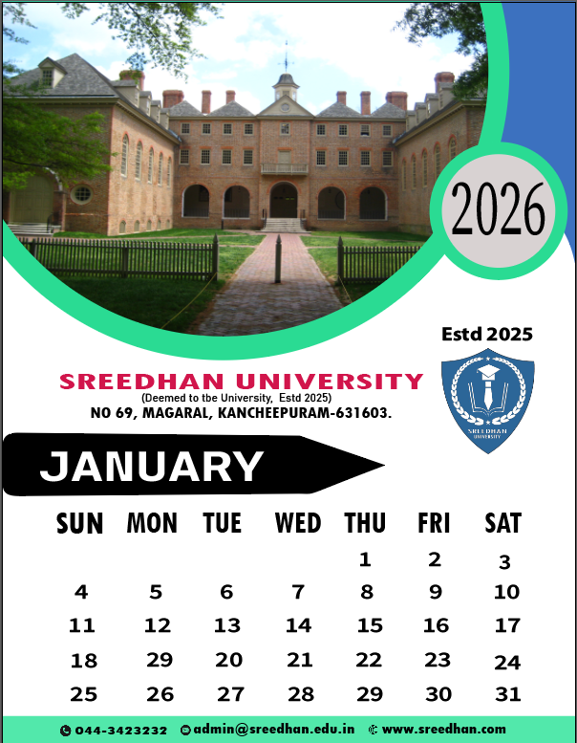
AN EDUCATION INSTITUTION GRAPHIC DESIGN PROJECT
CALENDER
DESIGN
Reinforce the university’s image through logos, colors, and official themes. Provide students, faculty, and staff with key academic dates, deadlines, and events. Promote participation in university events, workshops, and extracurricular activities. Help students and faculty manage their schedules efficiently. Feature university milestones, quotes, or notable alumni to inspire the community.

Slide 12
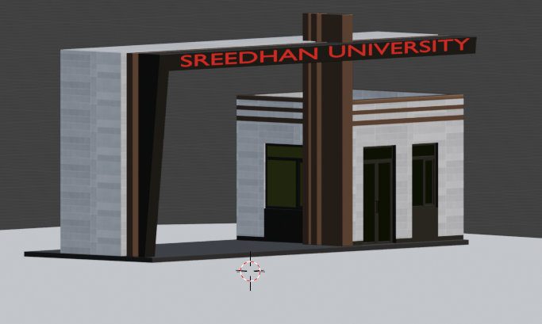
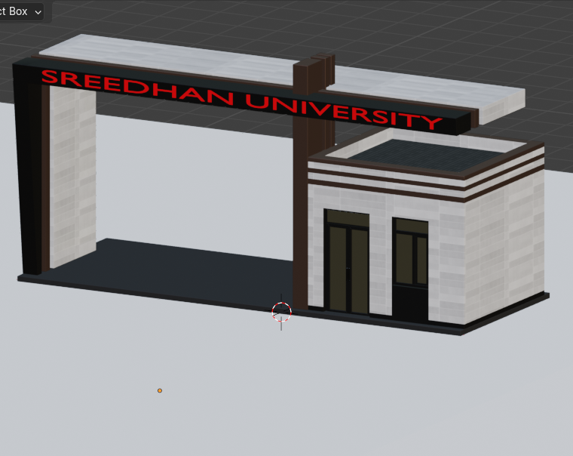
AN EDUCATION INSTITUTION GRAPHIC DESIGN PROJECT
3D MODEL COLLEGE
ENTERANCE

Slide 13
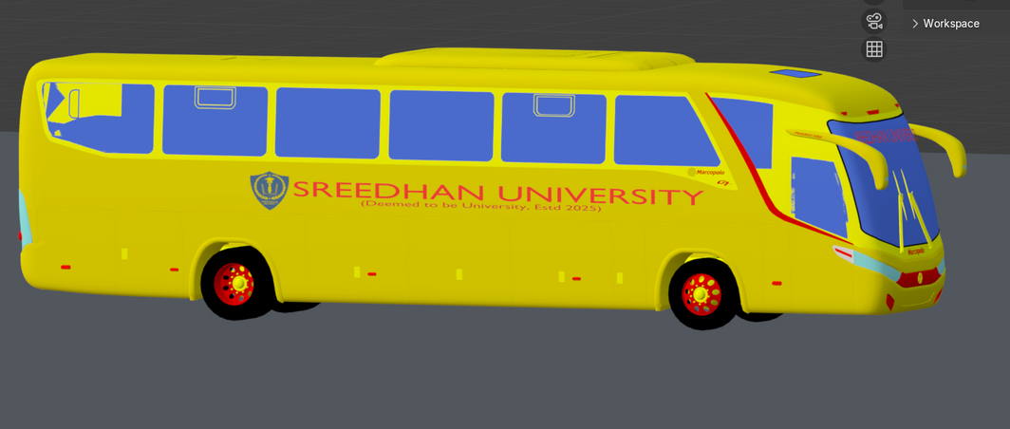
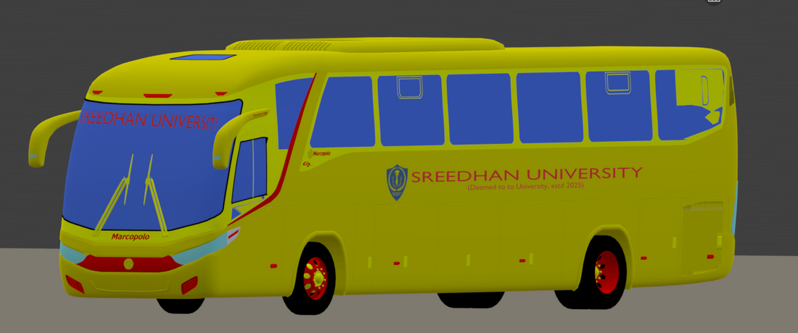
AN EDUCATION INSTITUTION GRAPHIC DESIGN PROJECT
3D MODEL COLLEGE
BUS

Slide 14
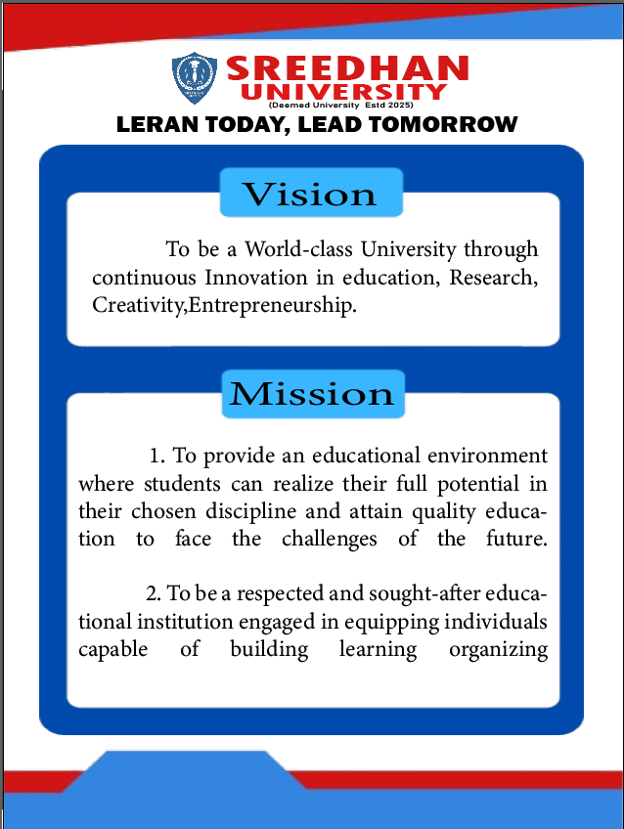
AN EDUCATION INSTITUTION GRAPHIC DESIGN PROJECT
UNIVERSITY
VISION
AND
MISSION

Slide 15

AN EDUCATION INSTITUTION GRAPHIC DESIGN PROJECT
OUR COLLEGE PAMPHLET
A university pamphlet is a visually appealing and informative document used to showcase academic programs, campus facilities, admission details, and student life. It should be well-structured, featuring an eye-catching layout with high-quality images, clear typography, and concise content. The design should reflect the university’s identity through appropriate colors and branding elements. A balanced mix of text and visuals ensures engagement, while a professional yet creative approach makes the pamphlet more appealing. The content should be easy to read, highlighting key information at a glance.

Slide 16

AN EDUCATION INSTITUTION GRAPHIC DESIGN PROJECT
OUR UNIVERSITY SAMPLE GRADUATION CERTIFIACTE

Slide 17
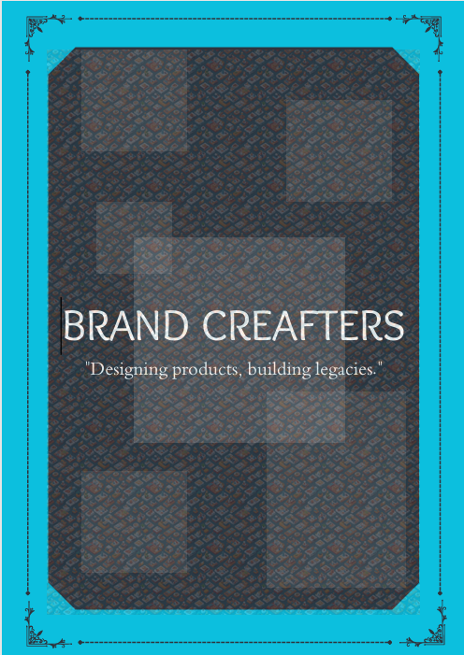
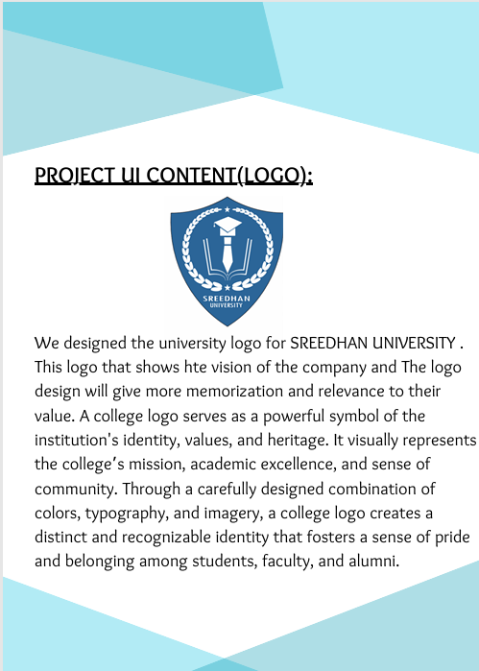
OUR GRAPHIC DESIGN BOOK
BRANDCRAFTERS

Slide 18



